Slide 1

BLOCKCHAIN TECHNOLOGY

Slide 2

blockchain technology
Blockchain technology is a digital peer-to-peer network powered by the innovative, secure, reliable software platform for the management and processing of customers’ transactions without any centralized control and management mechanism.

Slide 3
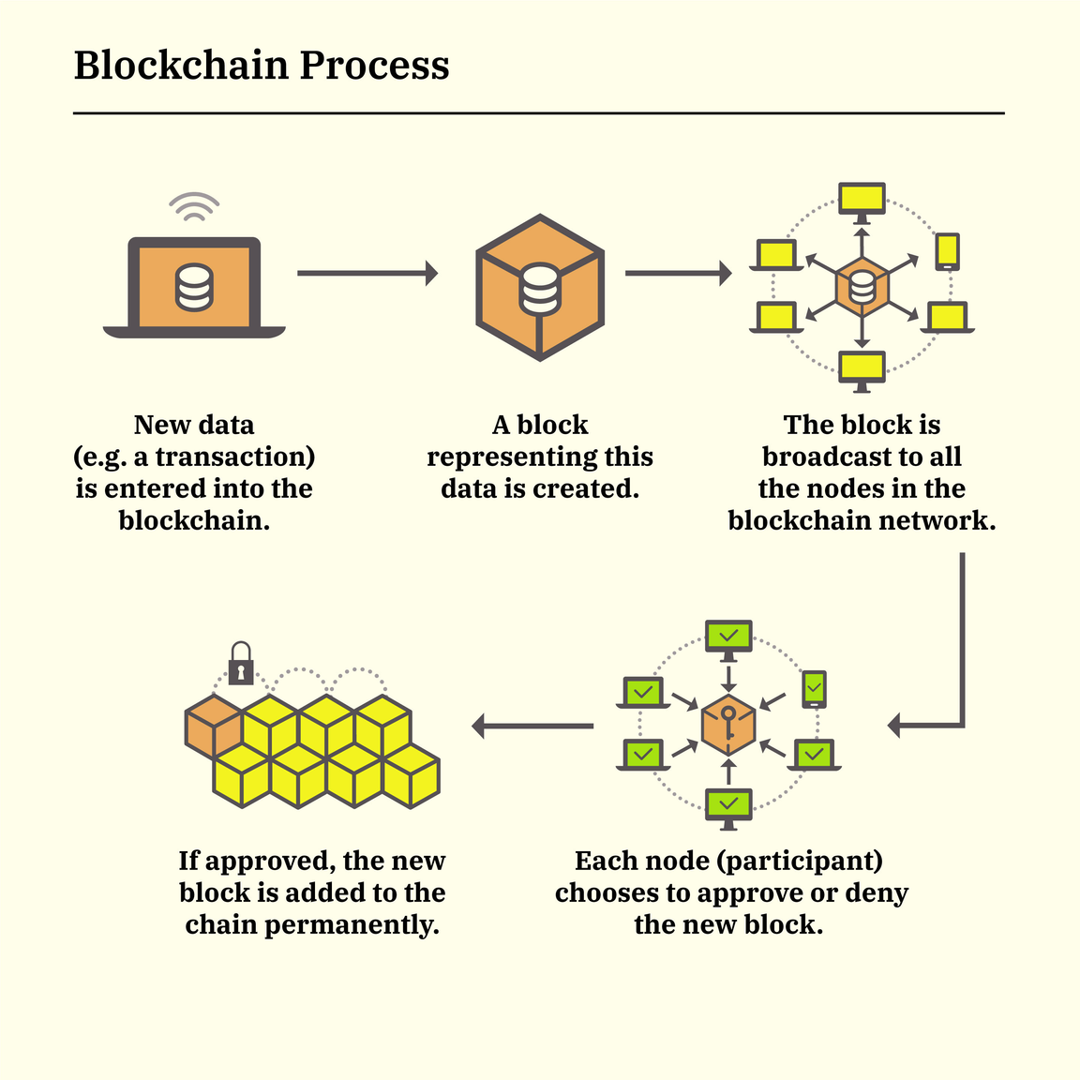
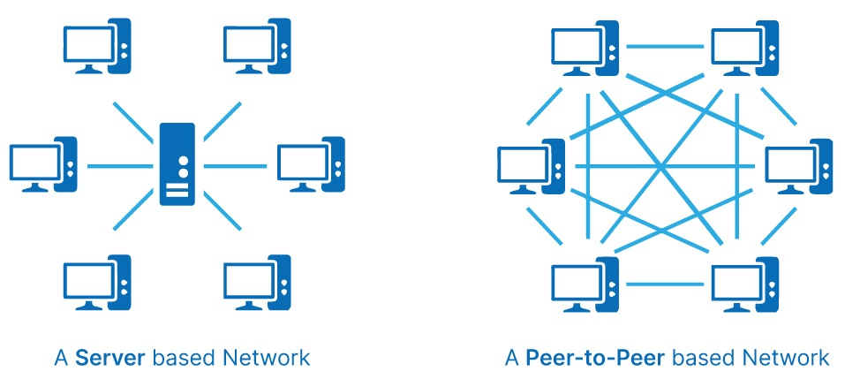
the blockchain process

Slide 4
Features of blockchain technology
A peer-to-peer network of diverse nodes that check, verify, share, and store the transactional activities on the network.
Referred to as a digital distributed ledger of immutable records of assets.
Entire verified record is stored in block of information, which is shared with all nodes of the network simultaneously.
Each node participates in verification and authentication process of a transaction through different techniques to build consensus among the nodes
At the core of the blockchain technology stands three main technologies

Slide 5
Features of blockchain technology
This technology uses two types of cryptographic keys known as private and public keys.
One user of the technology is defined by both of the private and public keys jointly referred to as “digital signature” or digital identity
Numerous types of assets, both tangible and intangible can be traded and managed through this secure technology of distributed ledger
It reduces the cost of ledger management and transaction management in any kinds of business and removes the barrier and charges of using the services of third-party or government agencies for their approvals and agreements.
It is highly secure and immutable technology, which cannot be tempered

Slide 6
Features of blockchain technology
It can be used in a range of applications such as cryptocurrency, voting systems, government data management such as lands, revenue, contracts, purchases, inances, banking and insurance, defense and security, and many others.
“Smart Contracts” is another futuristic use of this technology to automatically manage the entire process, activities, transactions, modification, changes, and other aspects of a business contract based on well-defined rules through this technology.

Slide 7
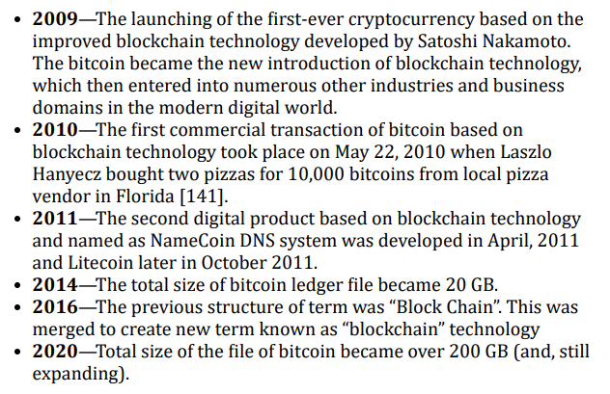
HISTORY of blockchain technology
The first trace of this technology can be found in the work of David Chaum, who enunciated a mechanism or protocol, which is like blockchain technology in 1982 in his research dissertation named as “Computer Systems Established, Maintained, and Trusted by Mutually Suspicious Groups”.

Slide 8
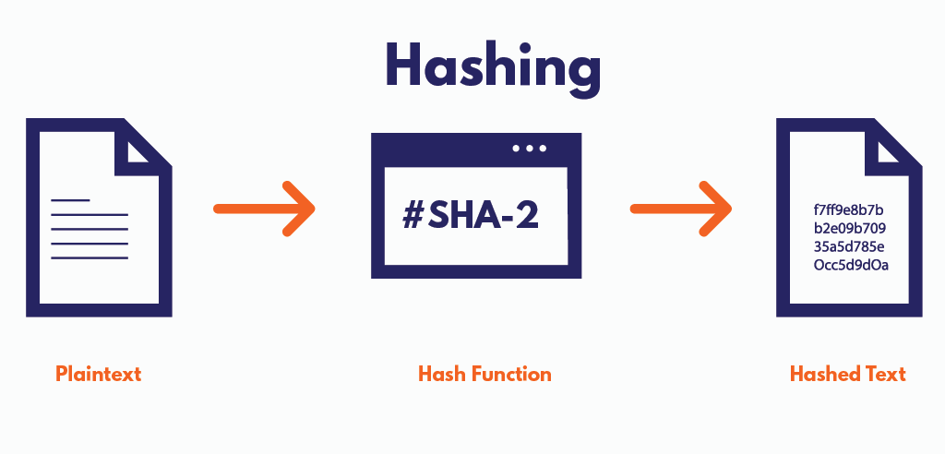
CRYPTOGRAPHIC HASH
Cryptographic hash is an output code of a message of arbitrary size produced in equal length of code through cryptographic hash function generating algorithm.

Slide 9
Features of cryptographic hash
Hash code is easy to create with the help of an algorithm and almost impossible to break.
It is not understandable though you can read the characters—letters and numbers used in the message but no meaning can be achieved.
The cryptographic mechanism has different types, sizes, and formats of input data but it encrypts into a same-sized output message based on the technology used in hashing algorithm.
The basic function of hashing is to compress the input message into a smaller size and cryptographic process means the encoding of the entire message.
The encrypted hash code acts like a fingerprint of the file encoded with the cryptography.

Slide 10
Features of cryptographic hash
A minor change in the input message alters the output cryptographic hash message hugely that is known as Avalanche Effect.
Cryptographic hashing is referred to as non-reversible or you cannot break and get the input message from the output code.
Creation of similar hash code is almost impossible due to the ability of the cryptographic hash of message collision resistance.
Cryptographic hashing is based on mathematical procedure to generate unique output strings of data through a mathematical algorithm.
Cryptographic hashing is also known for its foreordain property, which means that the output code for the same message is always the same.

Slide 11
Features of cryptographic hash
The main domains of application of this hashing function include:
– Duplication detection or unique file detection applications
– Fingerprinting and password verification processes
– Digital signature applications
– Proof of Work (PoW) and Proof of Stake (PoS).
The most common cryptographic hash algorithms used in the modern technological sphere include MD5, SHA-1, Bcrypt, Whirlpool, AES, and others.

Slide 12

Transaction
A transaction in blockchain technology is a procedure of activities to send message/data from one user account to the other concerned user accounts.

Slide 13
STEPS THAT constitute a transaction in BC
The request for a transaction originates from a single end-user in the blockchain network
An authentication process starts for that particular request before further-proceeding
A block is created representing that particular transaction
All nodes of the blockchain nodes get the copy of that transaction block
Each node has to validate that transaction based on certain validation procedure
The nodes are rewarded for their work of validation know as Proof of Work (PoW)
The verified block is added to the existing chain of blocks
The update is sent out across the network to all nodes in the blockchain network

Slide 14

proof of work
Proof of Work, precisely referred to as PoW in blockchain technology, is a process of developing consensus on the validation of a transaction and mining of a new blockchain token.

Slide 15
characteristics of POW
A decentralized consensus procedure in which the members of the blockchain network expend efforts or work for solving an arbitrary mathematical puzzle for avoiding any kinds of misuse or malicious use of the network
This process is extensively used for cryptocurrency mining and transaction validation.
This automatic mechanism plays the role of third-party verification agents used in the traditional systems of transactions.
Due to extensive usage of power on computing for solving the puzzle, PoW is being replaced by a new method of consensus known as Proof of Stake (PoS)
This is also known as the proof of expending the computational resource or power in the network for achieving the consensus on the work performed by a node.

Slide 16

BLOCK
Block is a kind of data structure used in the blockchain technology to store the entire details of a transaction in it.

Slide 17
characteristics of A BLOCK
A block is a permanent storage container of data of a validated transaction, which cannot be altered or removed once it is closed
A block contains the encrypted data from the previous blocks and the future blocks to make it more robust and reliable.
The new block is created only after the validation of the information in a particular block by developing consensus among the nodes.
Blocks of information can be used for a range of transactional information including cryptocurrency, governmental activities, revenue transition, and many others.

Slide 18

MINING
Mining is a process that is used in cryptocurrencies to either generate the new coins or to validate the transaction over the blockchain network.

Slide 19
TIMESTAMP
The fingerprint or authorized code against a message that may be a value, title, text, or a digital asset when verified and stored in the block is known as the timestamp.

Slide 20
Cryptographic Keys
Cryptographic keys are two different types of keys or codes used in building digital signature for authentication of the ownership of the transactional data in a blockchain-based network.

Slide 21
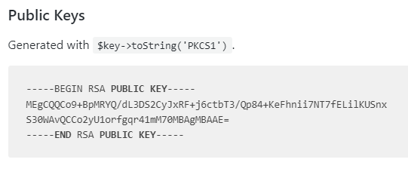
public key
A public key is a code that is used to identify the address of a user entity in the blockchain technology. It is also paired with the private key for establishing ownership on the assets associated with the private key or address.

Slide 22
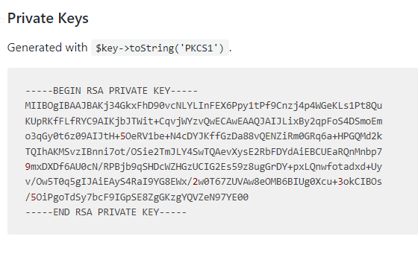
private key
Private key is very vital for the ownership, security, and control over the blockchain assets. It is a long string of digits, letters, or combination of both.

Slide 23
characteristics of A private key
It is a long, randomly-generated, and encrypted string of numbers or alpha-numeric characters.
Used for the authentication and ownership of the assets on blockchain.
Private keys are normally very long strings in such a way that they cannot be cracked through brute force attacks.
Creating a public address or public key from a private key is very easy and possible through a mathematical calculation or mathematical puzzle solution but the reverse engineering for decrypting private key is almost impossible
It should always be stored carefully and should never be shared with anyone

Slide 24
Peer-to-Peer Network with Shared Ledger
A peer-to-peer network with shared ledger is a network of wide range of nodes or computer machines installed with the blockchain technology that enables them to coordinate in a peer-to-peer network environment without any intervention of a server or any other network agent or any other third-party—either human or technological.

Slide 25
Computing Resources to Store Transactions and Network Records
The computing resources that are used for storing the network transactions on a blockchain technological network are those computing nodes that are private entities added into the global network of any private blockchain service or any private blockchain service.

Slide 26
How Does Blockchain Technology Work?
A blockchain technology-based network consists of three main entities named as Node, Blocks, and Miners.

Slide 27
NODE
A node in this case is a computer machine that hosts the mining software, unique alphanumeric ID number, and distributed ledger of blockchain technology.

Slide 28
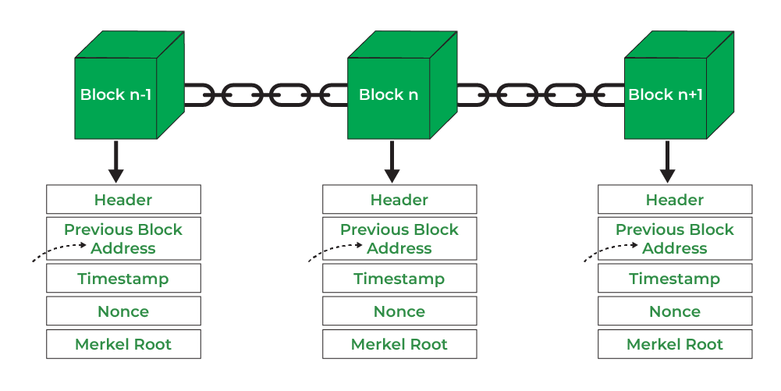
BLOCK
A block is the basic container that contains the encoded information or message including the transactional details in the chain.
Data
Nonce
Miners

Slide 29
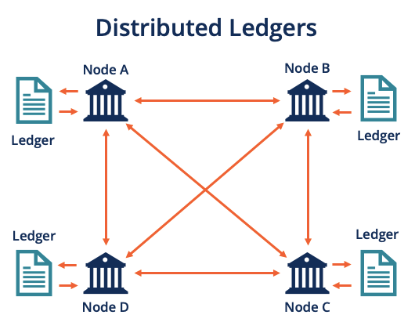
Distributed Ledger Technology (DLT)
Distributed Ledger Technology, precisely referred to as DLT, is a detailed structure of entire stack of blockchain technology protocols that enable the entire ecosystem of blockchain technology to create, authenticate, verify, and store the message or information in the encrypted form on a distributed ledger (of long queues of blocks of information located on every node in the network).

Slide 30
Permissionless blockchain category
In the permissionless category of blockchain, it is used in the way that no permission or control is established over the nodes of the network.

Slide 31
Permissioned blockchain category
In the permissioned category of blockchain, there is a centralized control of a group, consortium, or an authority. In this category, the nodes are granted permissions by the centralized authority thus, reducing the security-level, privacy, and other major features of the traditional blockchain technology

Slide 32
Hybrid blockchain network
The third category of blockchain technology is the middle-way of permissioned and permissionless. This uses the combination of the features of both categories

Slide 33
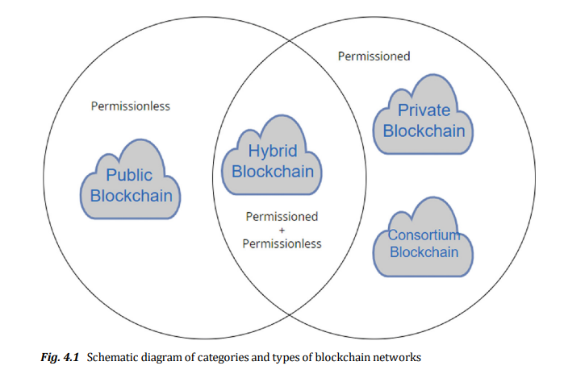

Slide 34
Public Blockchain
A sub-set of permissionless category of blockchain
Offers full decentralization of the control
No third-party is involved at any level of control
Any public node can participate in the network with basic prerequisites
All nodes have equal rights in the network to access and work in the blockchain network
All nodes can create new blocks, mine data, and authenticate transactions
The examples include bitcoin, Ethereum, Litecoin, and so on.

Slide 35
private Blockchain
A type of permissioned category of blockchain technology, which is fully managed by the third-party organizations or persons.
The centralized controlling authority of private network is one entity
Any new node to be added to the network is fully under the authority of the network management body
All nodes do not have equal rights delegated by the central management system
Public access to participate in the network is not allowed
The examples of private blockchain networks include Hyperledger, Ripple, and so on.

Slide 36
consortium Blockchain
It is a type of blockchain network that falls under permissioned category
The controlling authorities are more than one or a group of companies known as consortium
It is more decentralized in nature than the private networks, which are fully managed and controlled
More secure than public blockchain networks but less secure than private blockchain networks
The examples of consortium blockchain technology include CargoSmart, and R3 software consortium platform.

Slide 37
HYBRID Blockchain
Blockchains that are managed by one organization with limited features of private network and other features of a public network for maintaining higher level of security.
This is a domain-specific performance improving solution based on certain customized features and capabilities.
The example of hybrid blockchain type of technology include the IBM Food Trust designed for the improvement of the food supply chain’s performance while maintaining the high-level of security and privacy of the network.

Slide 38

uses of blockchain technology
Cryptocurrency
NFTs
Smart contracts
Financial Markets
Electronic Voting
Record Maintenance
Supply Chain
Government

Slide 39

Impact of Blockchain Technology on Cybersecurity
1
Exploitation of protocol vulnerabilities
2
Edge device vulnerabilities
3
DNS systems breaches
4
Internet of Things (IoT)
5
Data integrity breaches

Slide 40

THANK YOU FOR LISTENING!

